Slide 1
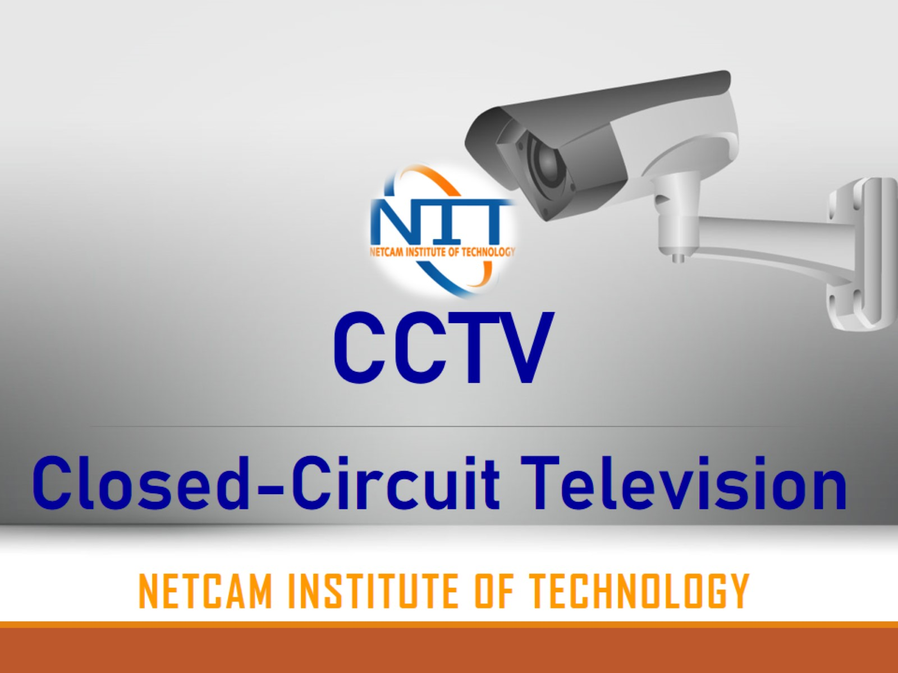
Closed-Circuit Television

Slide 2
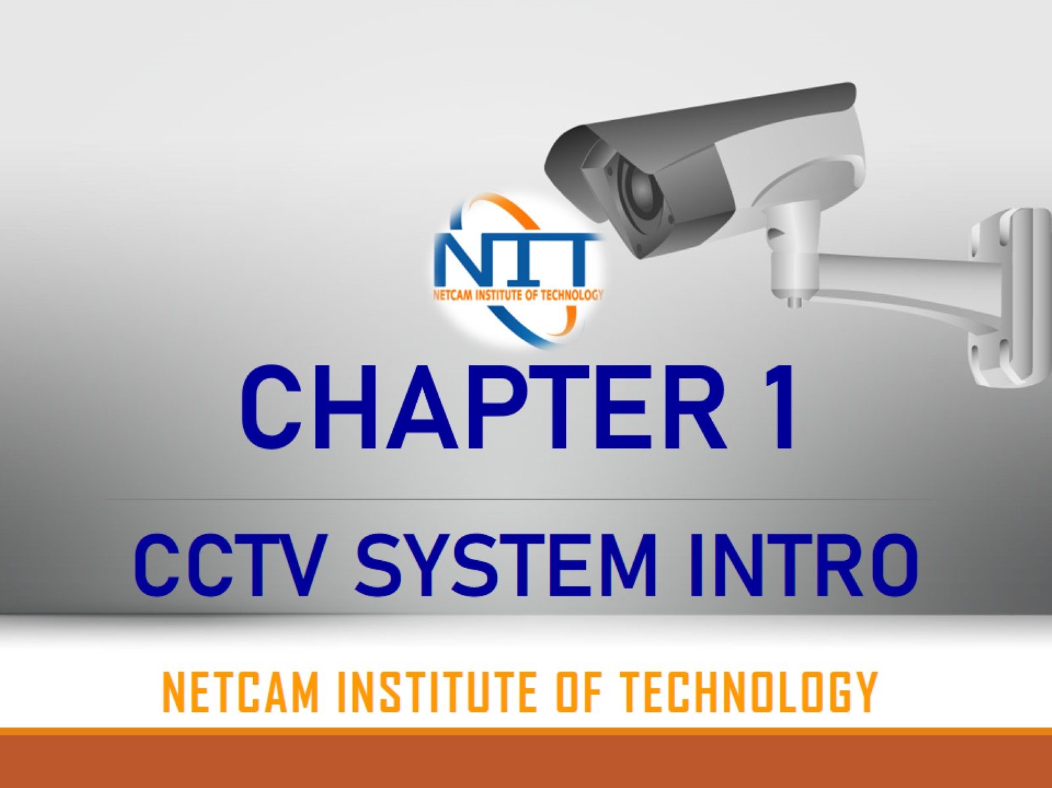
CCTV SYSTEM INTRO

Slide 3
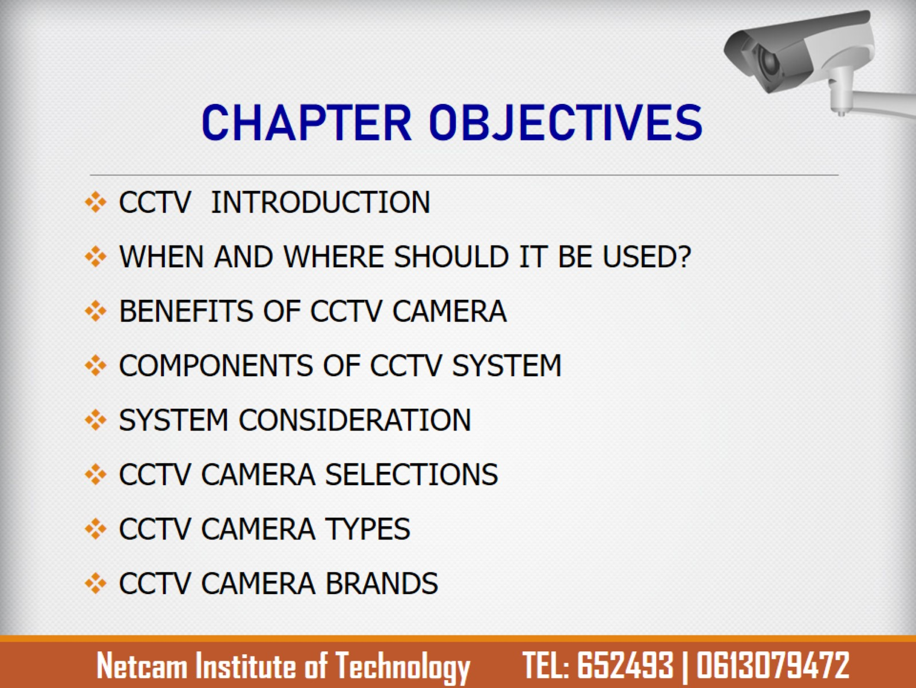
CHAPTER OBJECTIVES

Slide 4
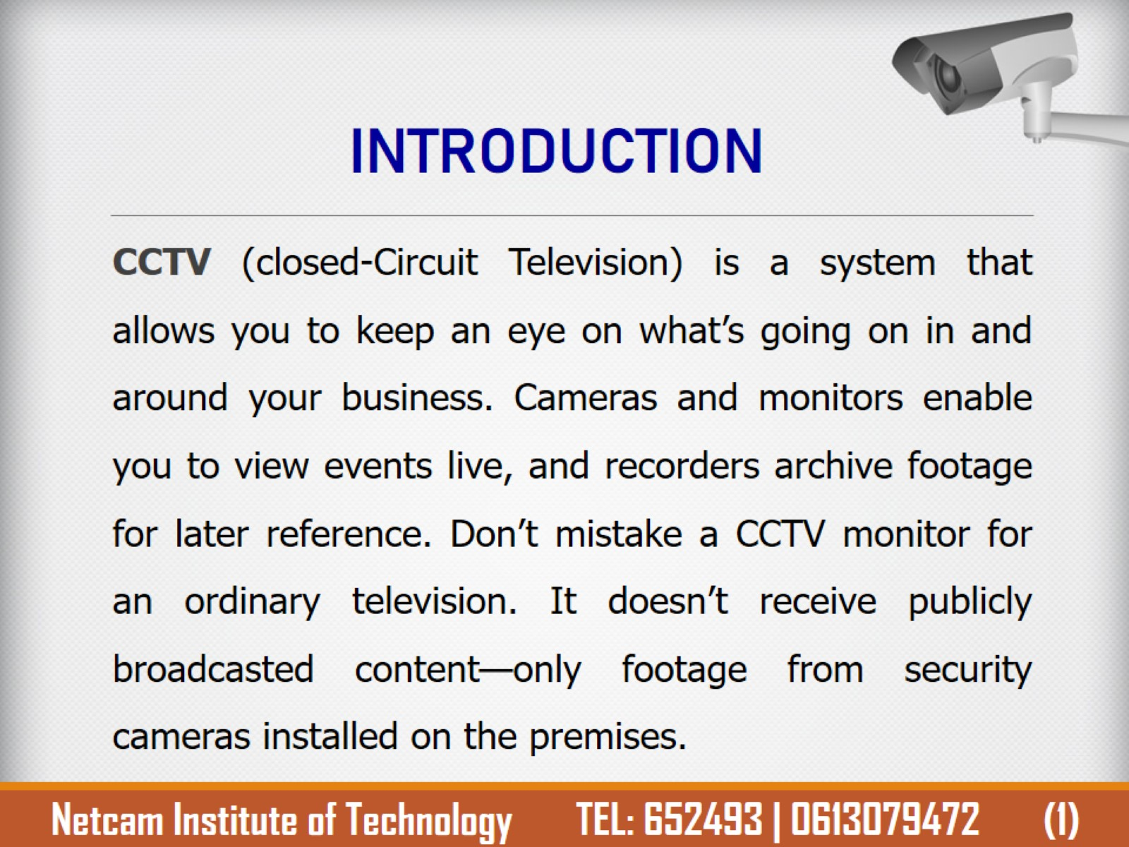
INTRODUCTION

Slide 5
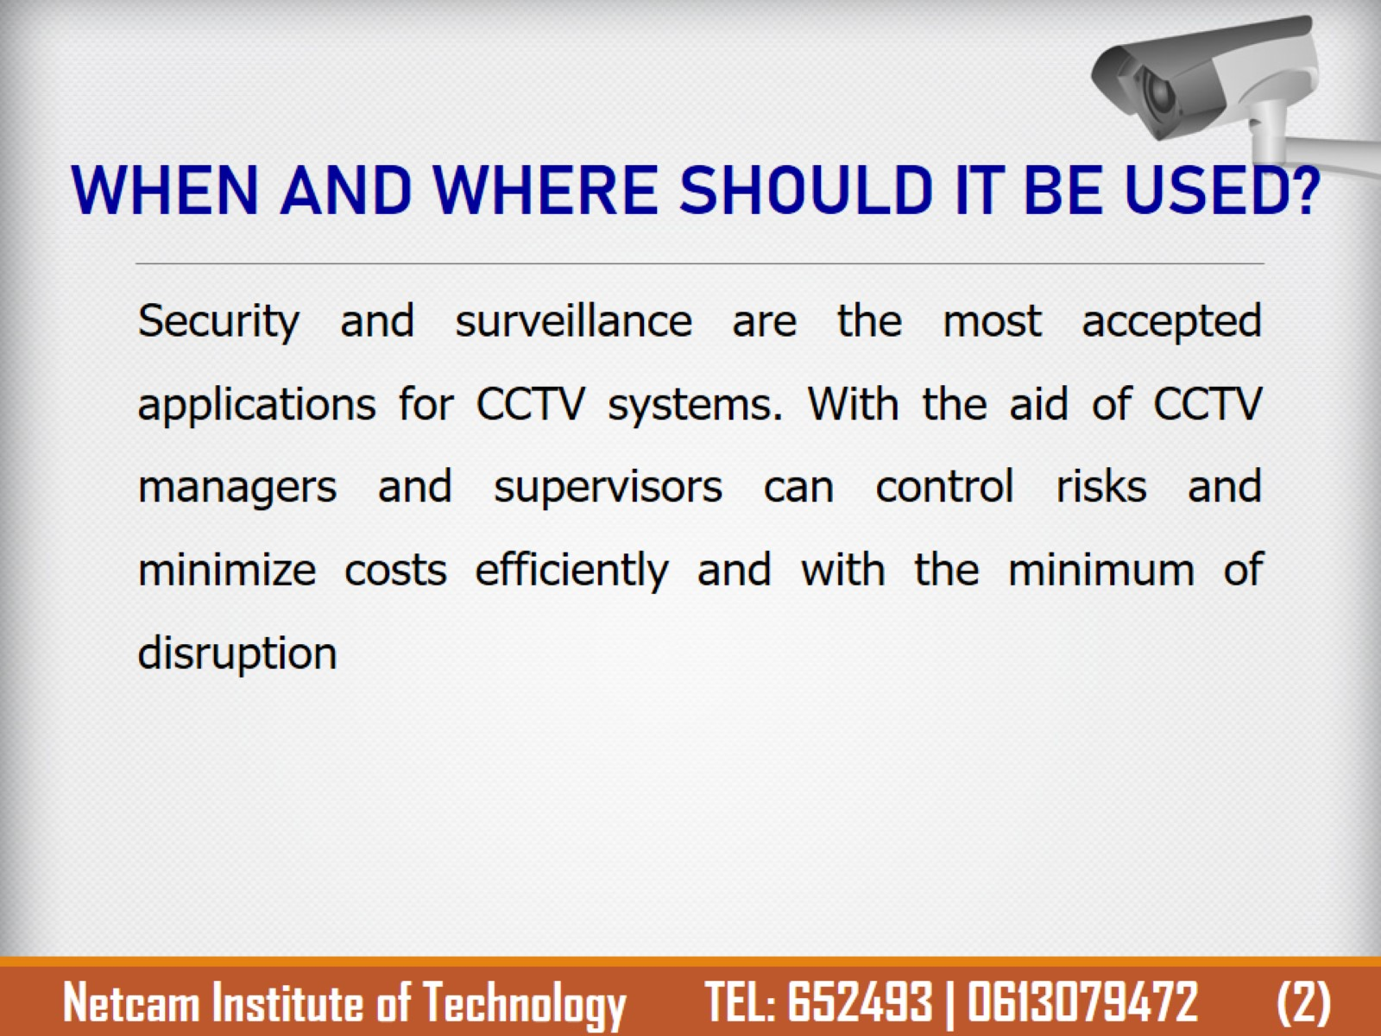
WHEN AND WHERE SHOULD IT BE USED?

Slide 6
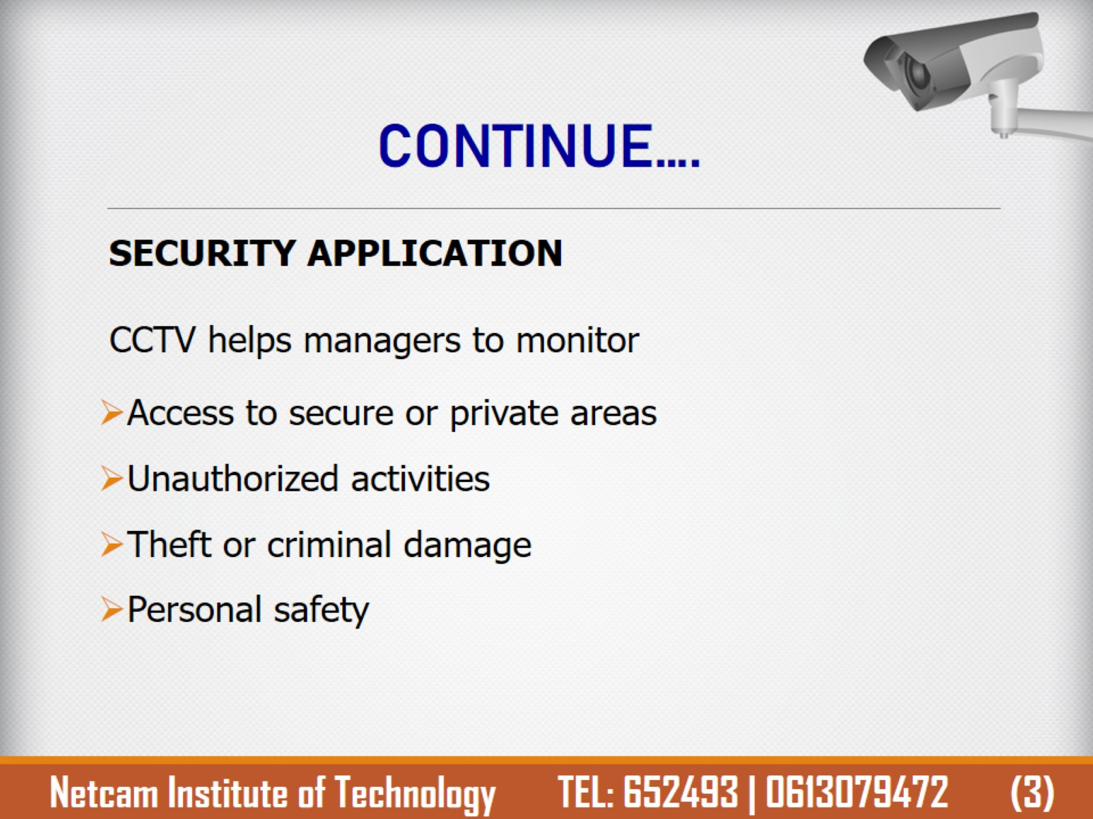
CONTINUE….

Slide 7
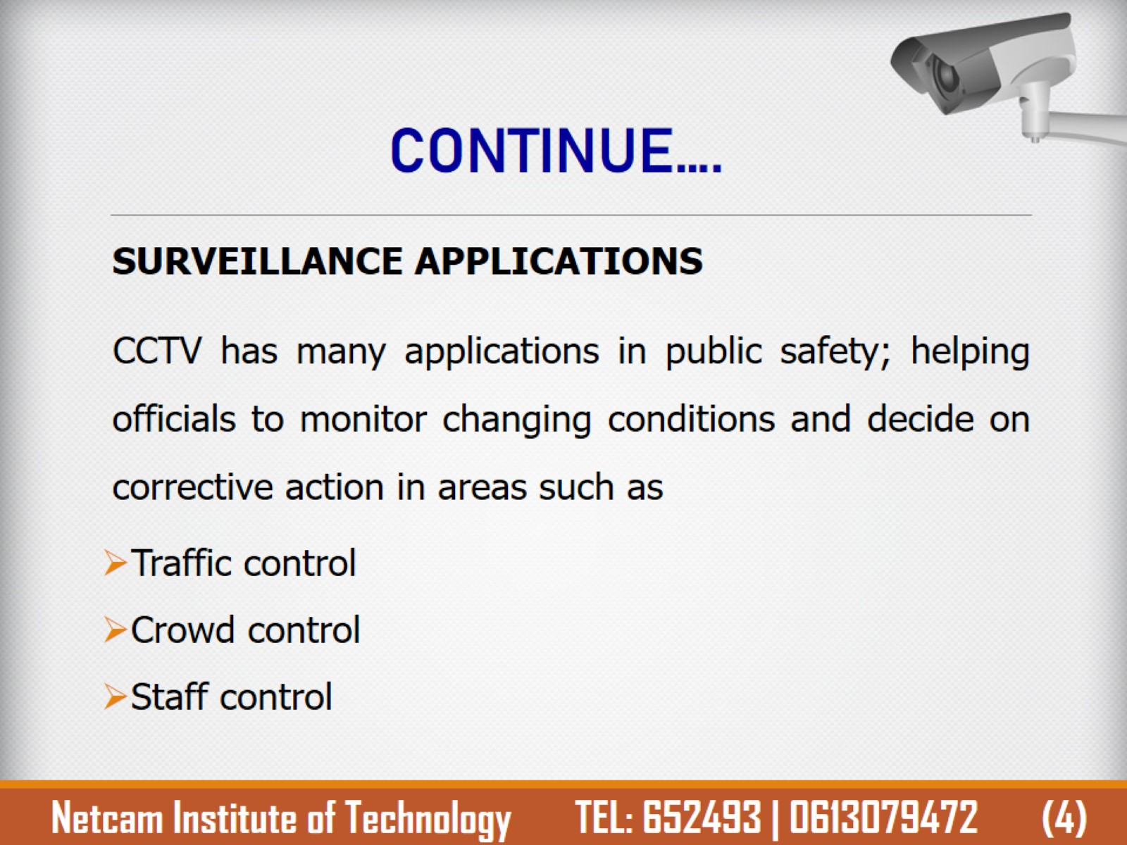
CONTINUE….

Slide 8
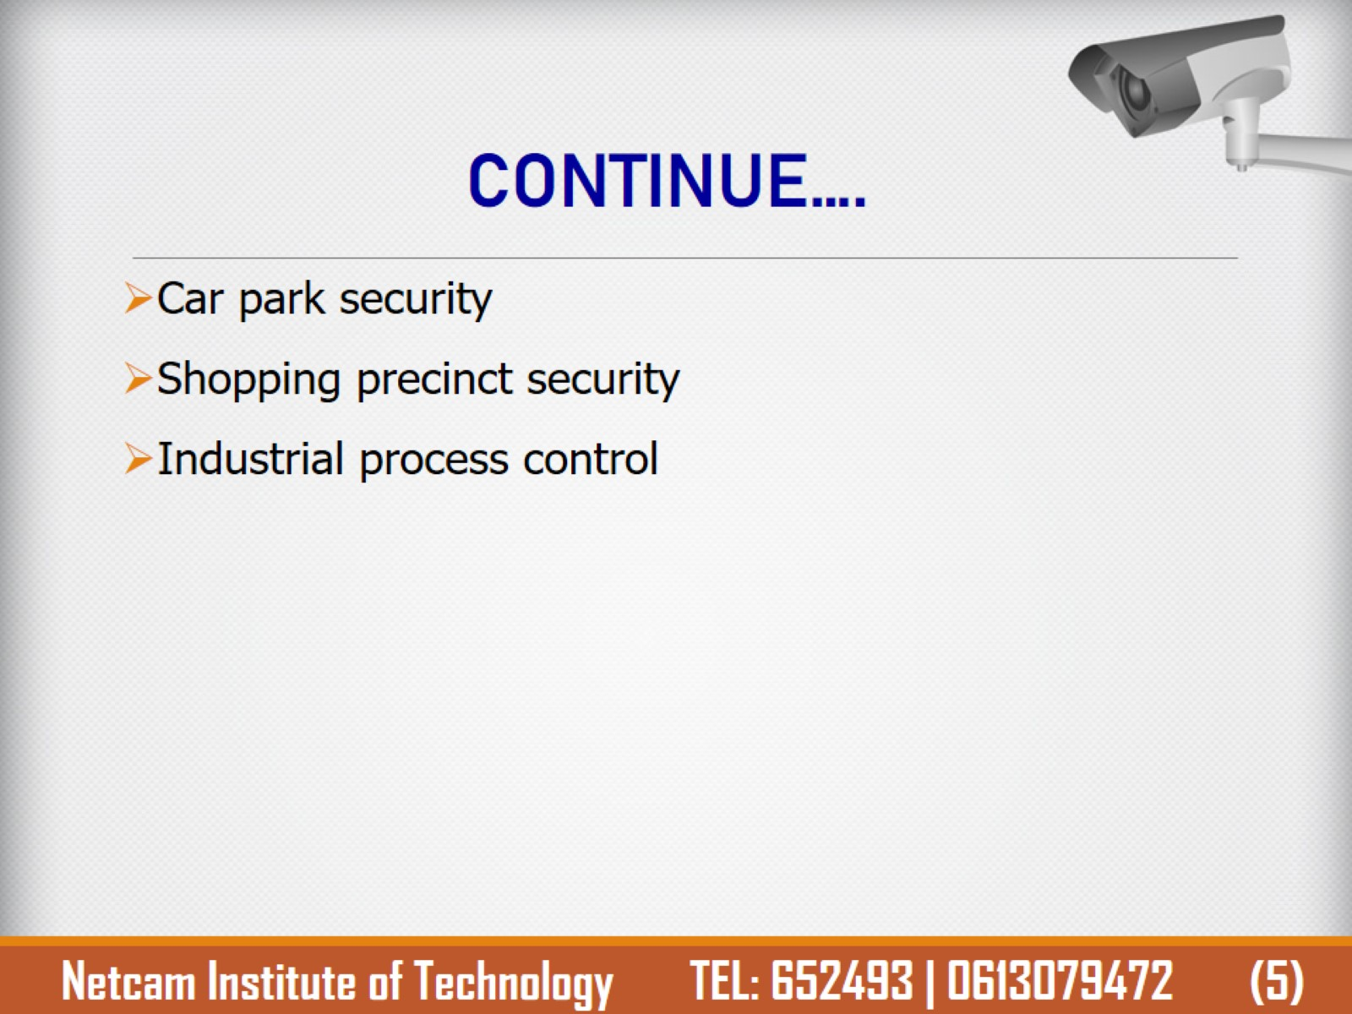
CONTINUE….

Slide 9
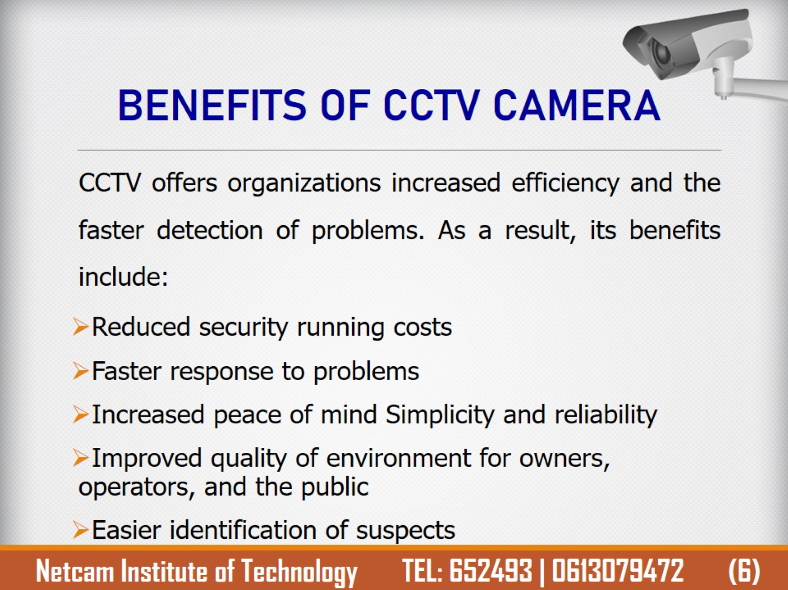
BENEFITS OF CCTV CAMERA

Slide 10
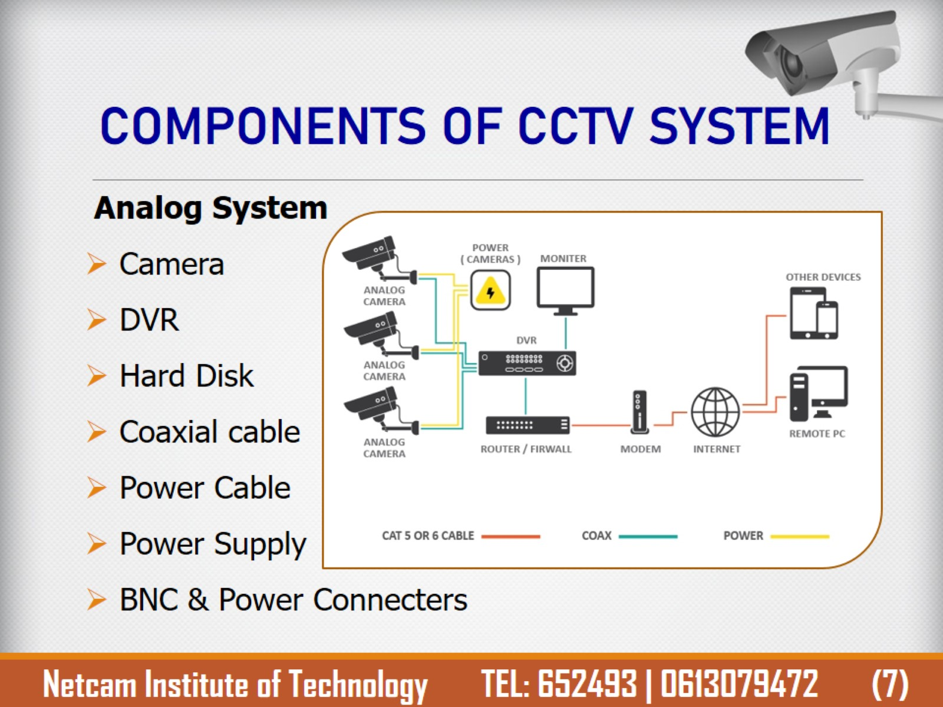
COMPONENTS OF CCTV SYSTEM

Slide 11
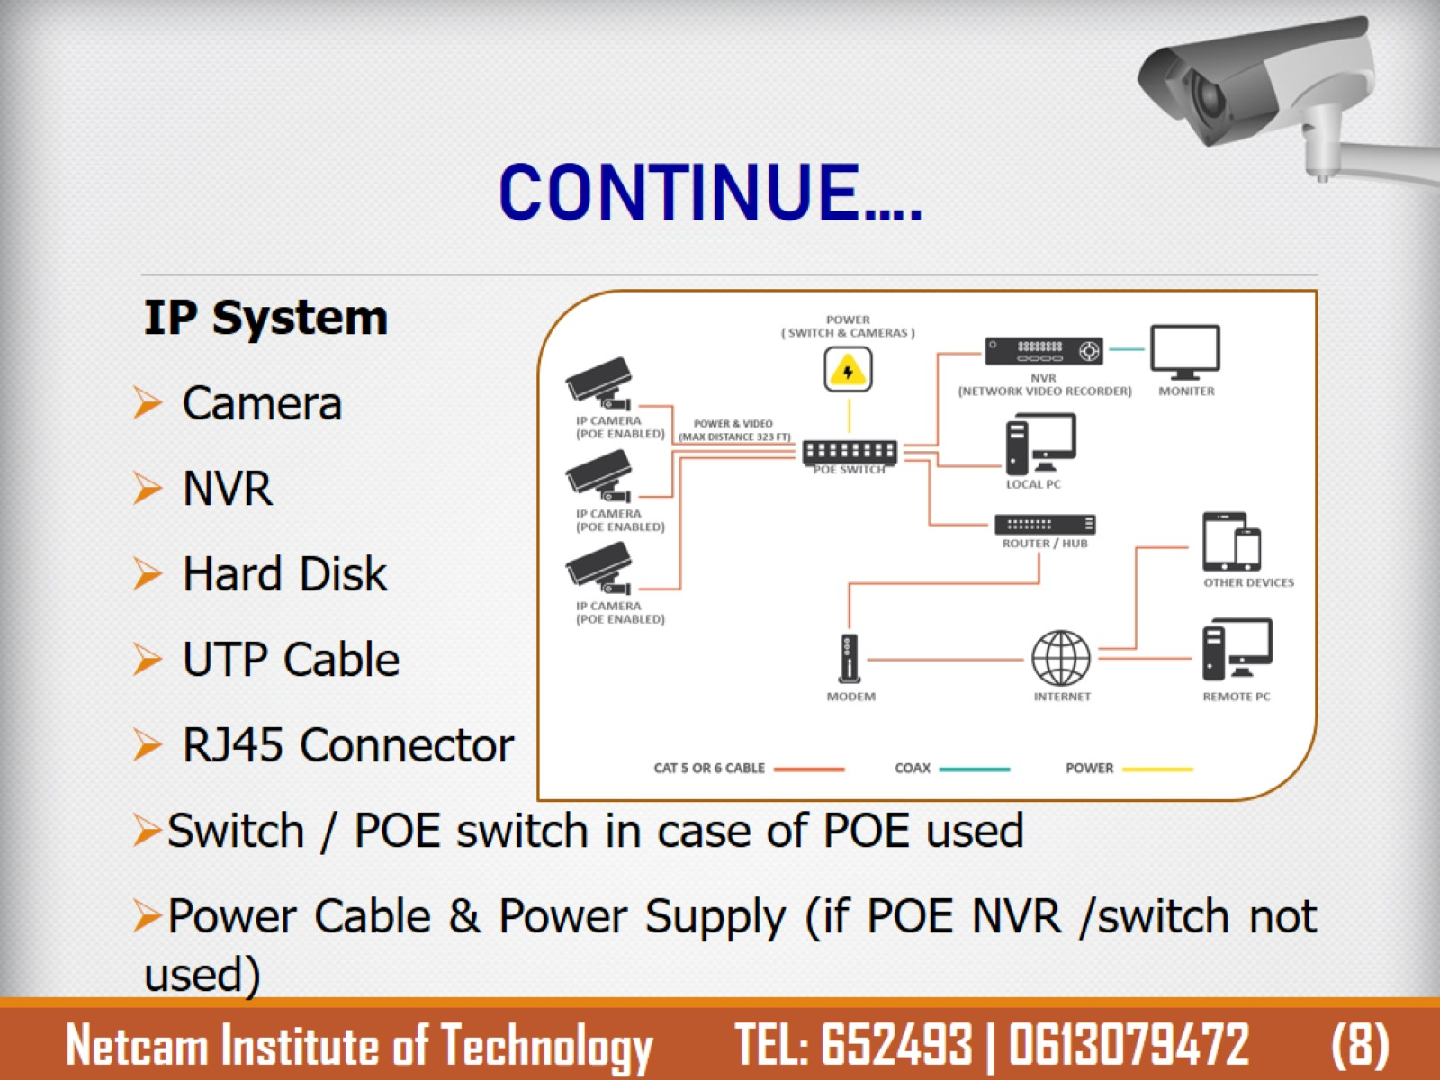
CONTINUE….

Slide 12
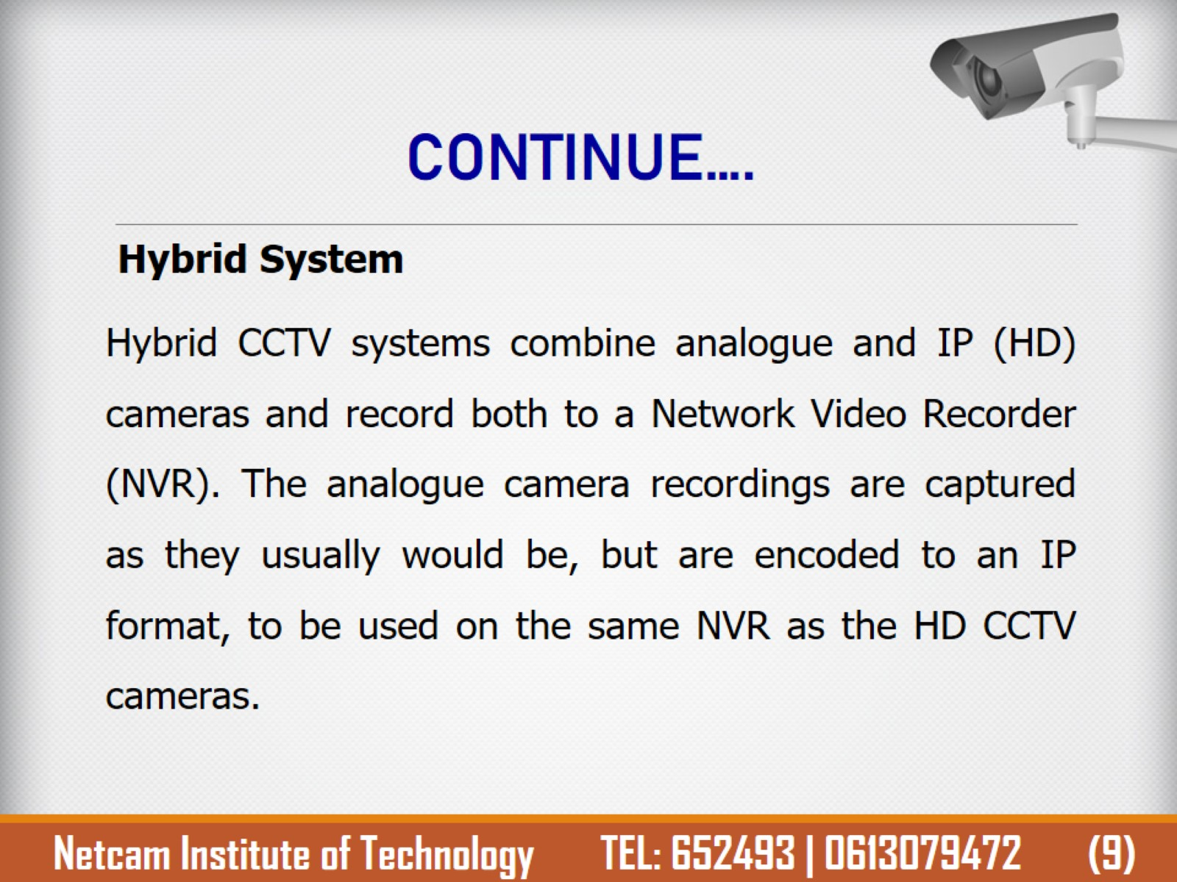
CONTINUE….

Slide 13
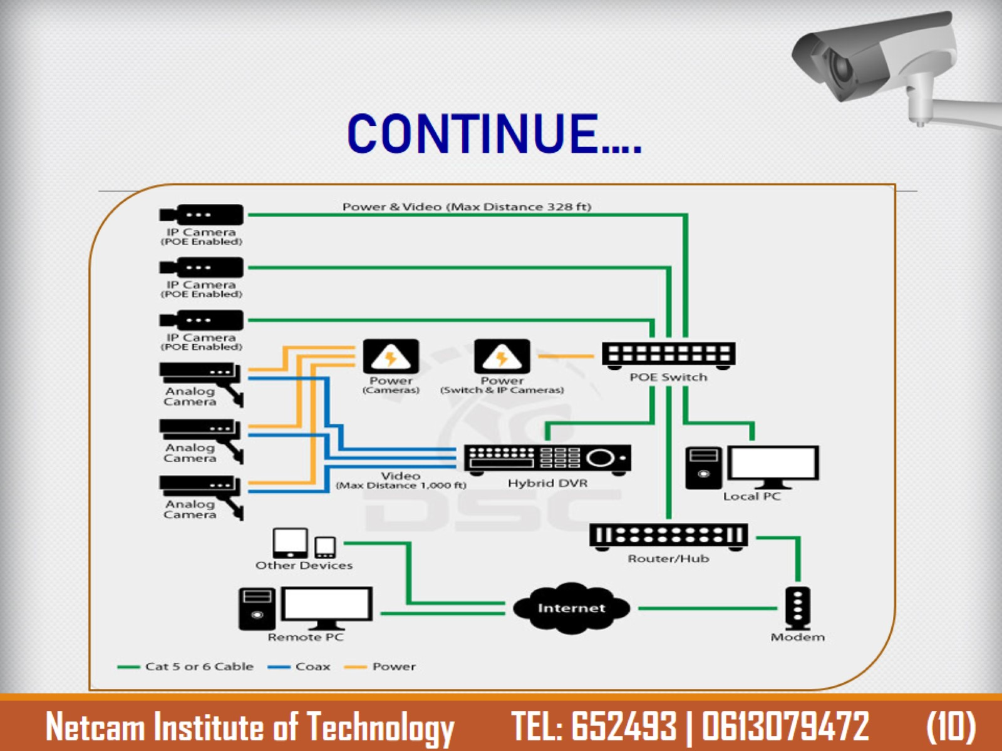
CONTINUE….

Slide 14
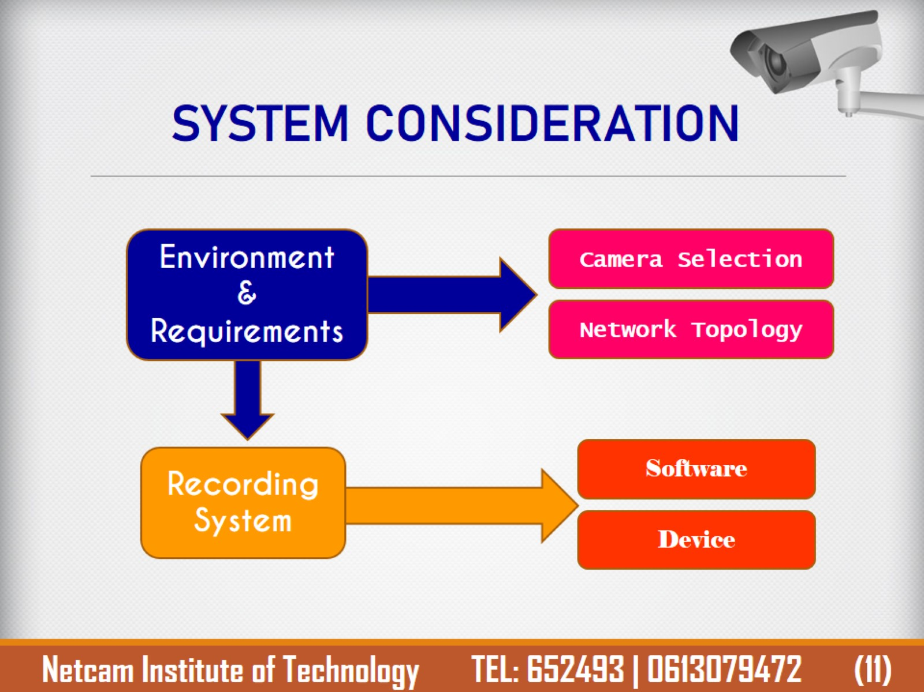
SYSTEM CONSIDERATION

Slide 15
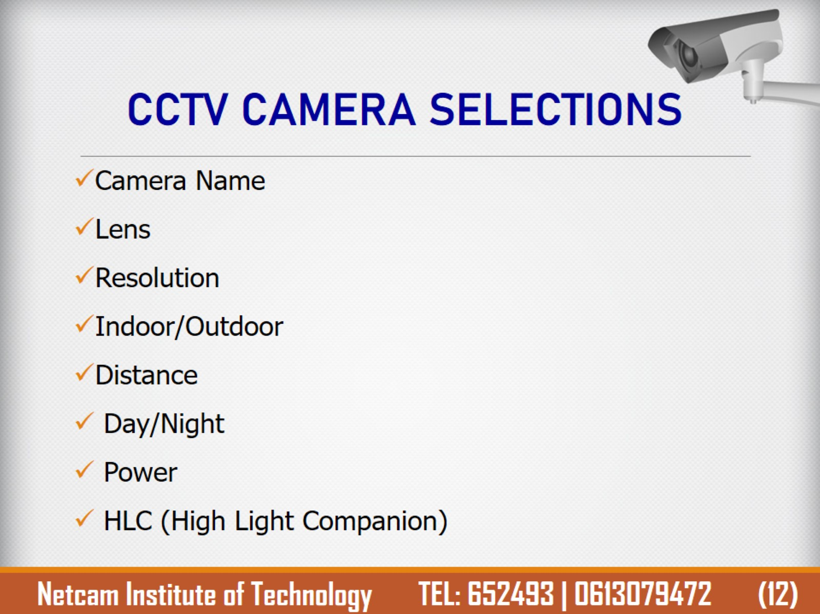
CCTV CAMERA SELECTIONS

Slide 16
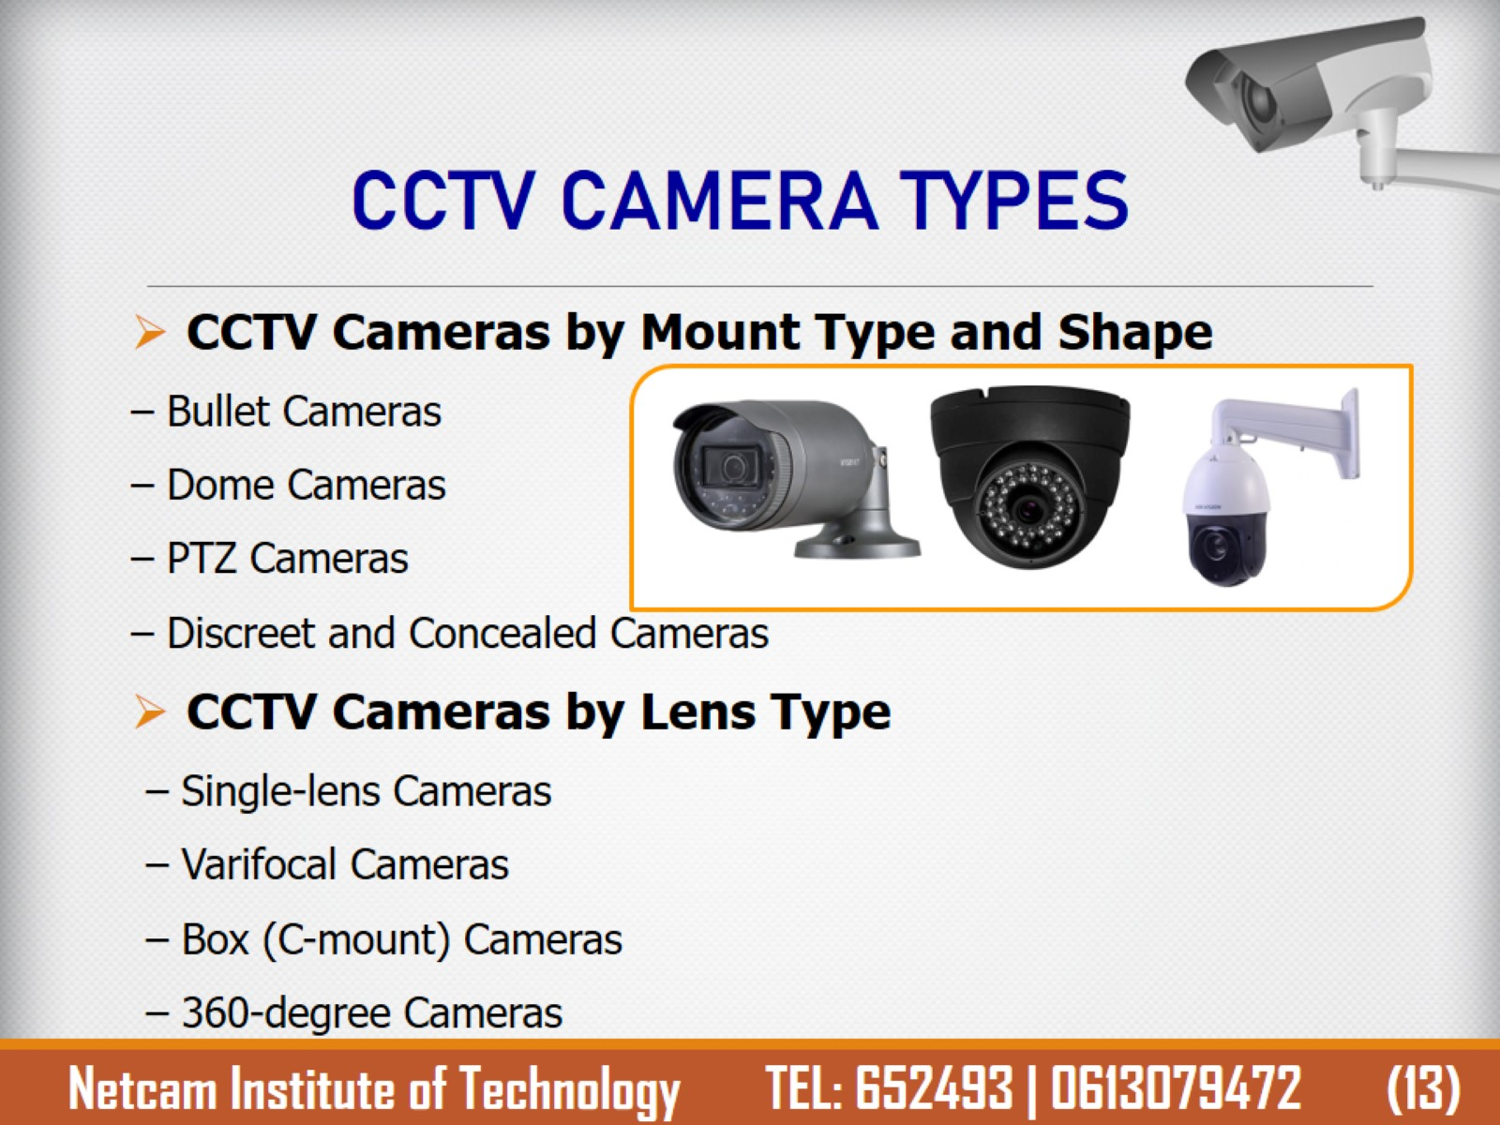
CCTV CAMERA TYPES

Slide 17
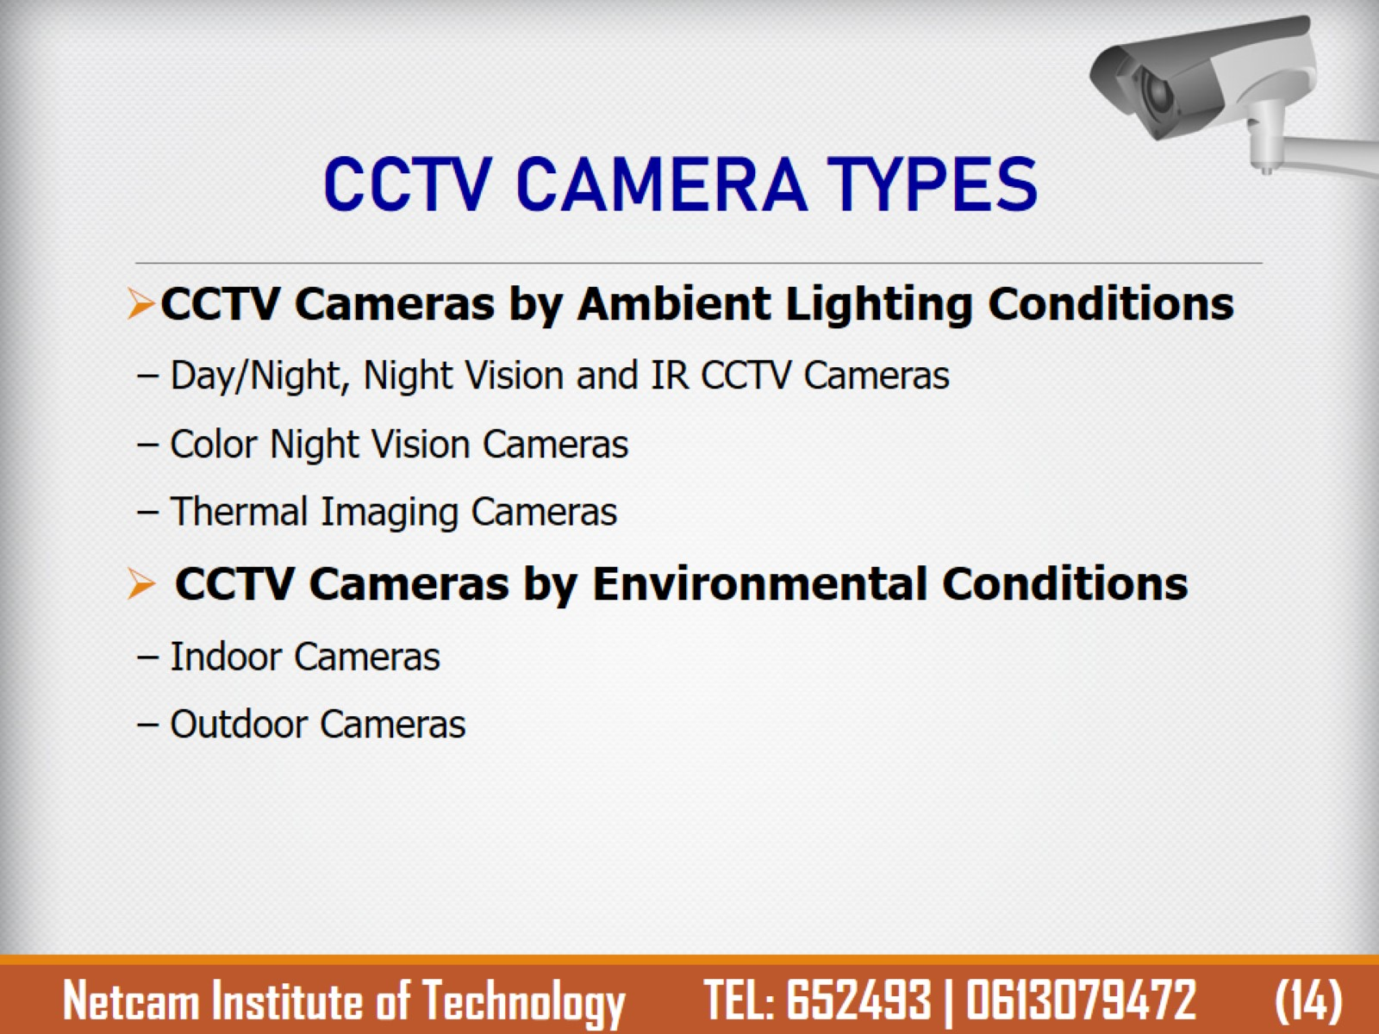
CCTV CAMERA TYPES

Slide 18
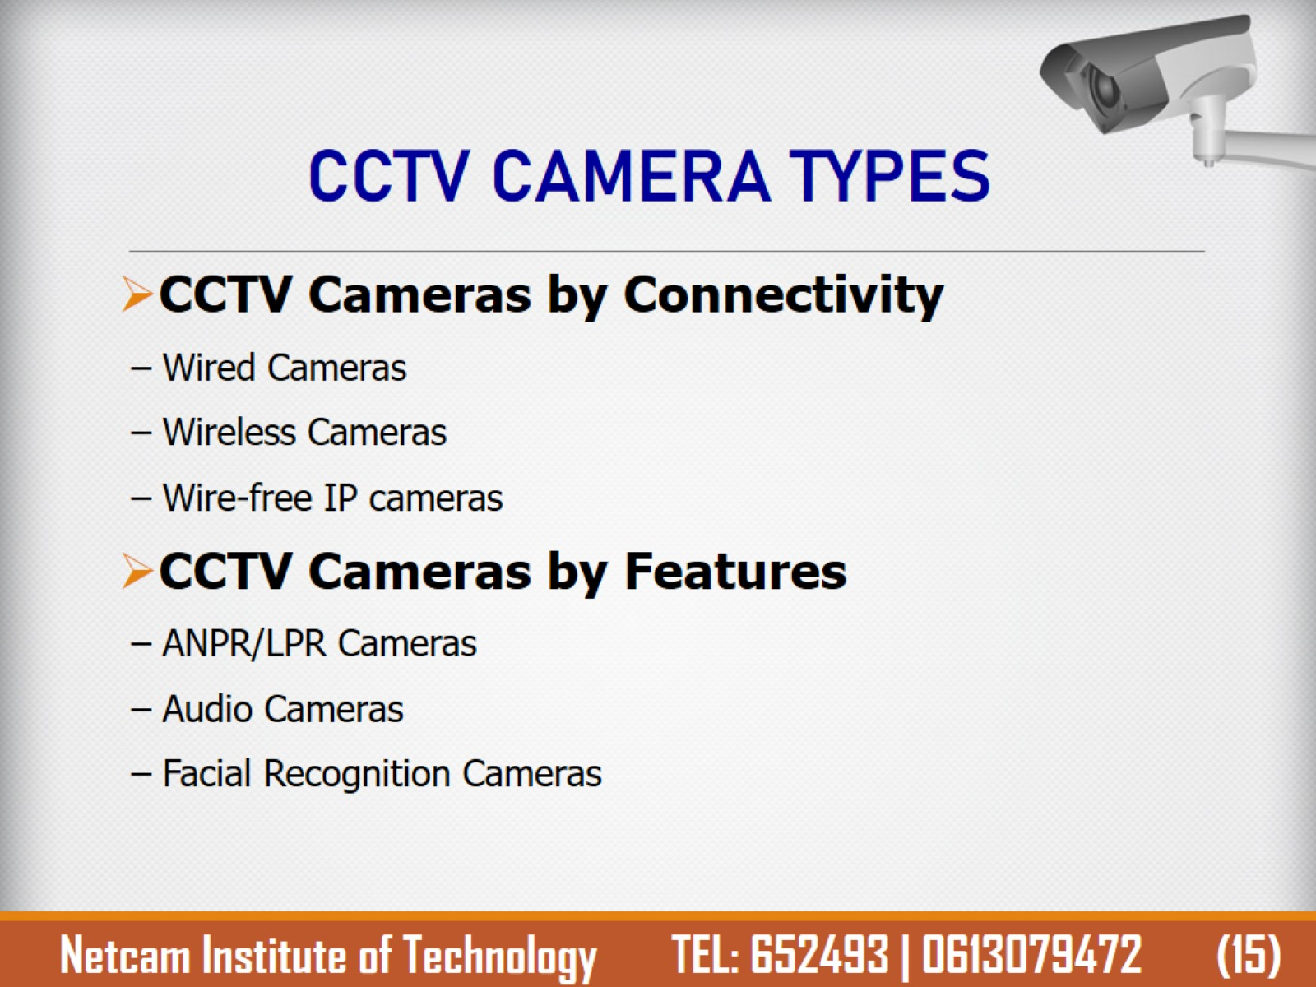
CCTV CAMERA TYPES

Slide 19
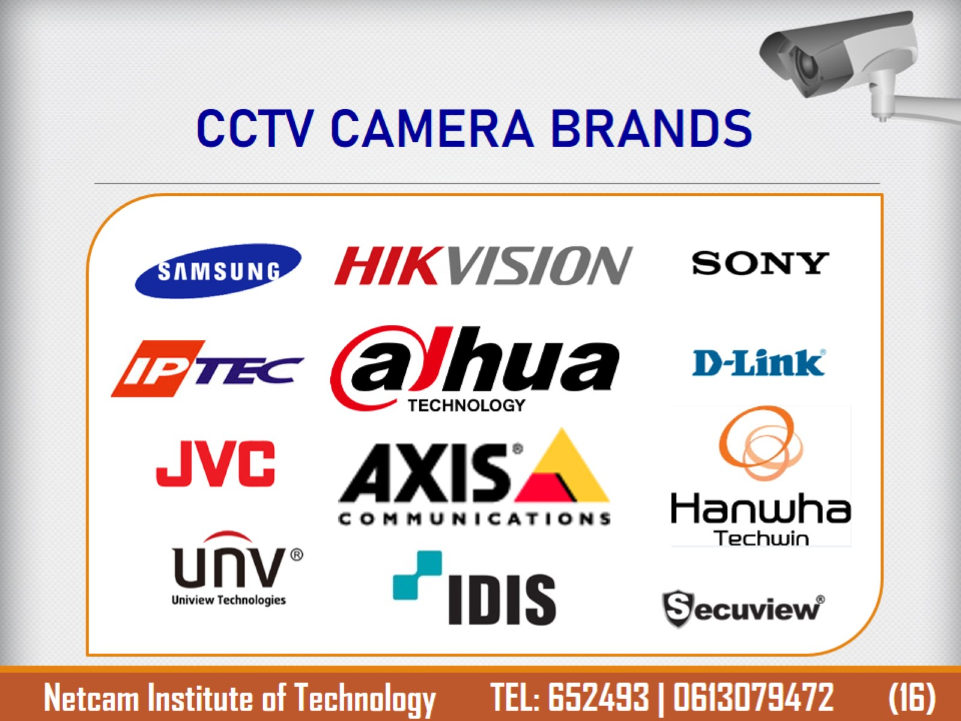
CCTV CAMERA BRANDS

Slide 20

END OF THE CHAPTER

